Slide 1

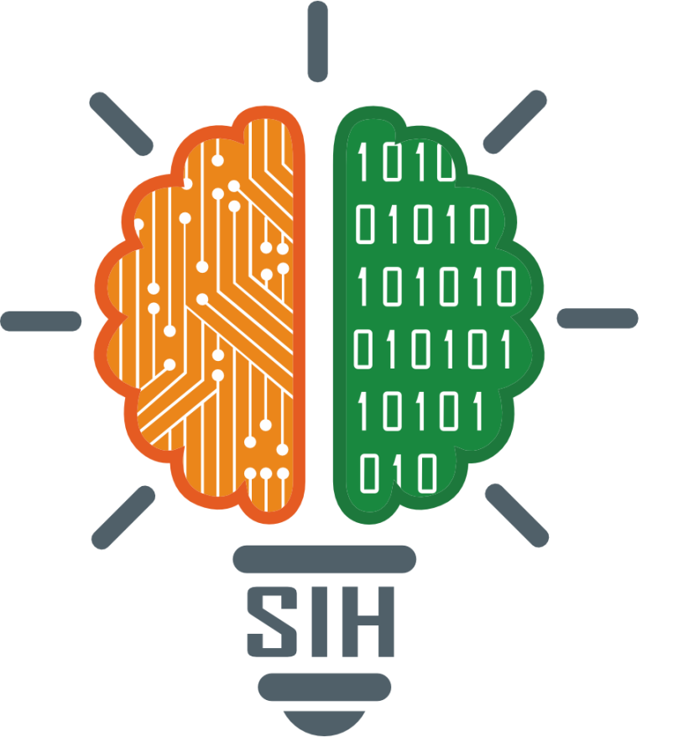
SMART INDIA HACKATHON 2024
TITLE PAGE
Problem Statement ID – SIH1645
Problem Statement Title- An app and web based software for productivity and safety management of coal mines.
Theme- SMART AUTOMATION
PS Category- SOFTWARE
Team ID-GUSIH256
Team Name- COAL MINE INNOVATORS

Slide 2
COAL MINE SAFETY AND MANAGMENT
Coal Mine Innovators
Proposed Solution
1. Digital Shift Handover Log System
Objective: Streamline and digitize shift handovers.
2. Digital Safety Management Plan (SMP)
Objective:
3. Data Security Considerations
Features:
App & web platform for supervisors/operators.
Digital templates for statutory/non-statutory logs.
Real-time updates/alerts for critical incidents.
Automated PDF report generation.
Search & filter past logs.
ERP integration.
Benefits:
Improved communication & productivity.
Enhanced safety monitoring.
Features:
Digital hazard identification & control mechanisms.
Checklists, dashboards, and incident tracking.
Digital responsibility assignments.
Automated audit/compliance reports.
ERP integration.
Benefits:
Better risk management & regulatory compliance.
Clear accountability & safety adherence.
Digitize SMP per DGMS guidelines.
Objective:
Ensure confidentiality, integrity, and availability of sensitive data.
Features:
Encryption: End-to-end data protection.
Role-Based Access: Controls data access by user roles.
Security Audits: Regular checks for vulnerabilities.
Backup & Recovery: Ensures data retrieval after incidents.
Benefits:
Data Security: Prevents unauthorized access.
Continuity: Safeguards operations during disruptions.
Risk Reduction: Minimizes chances of data breaches.

Slide 3
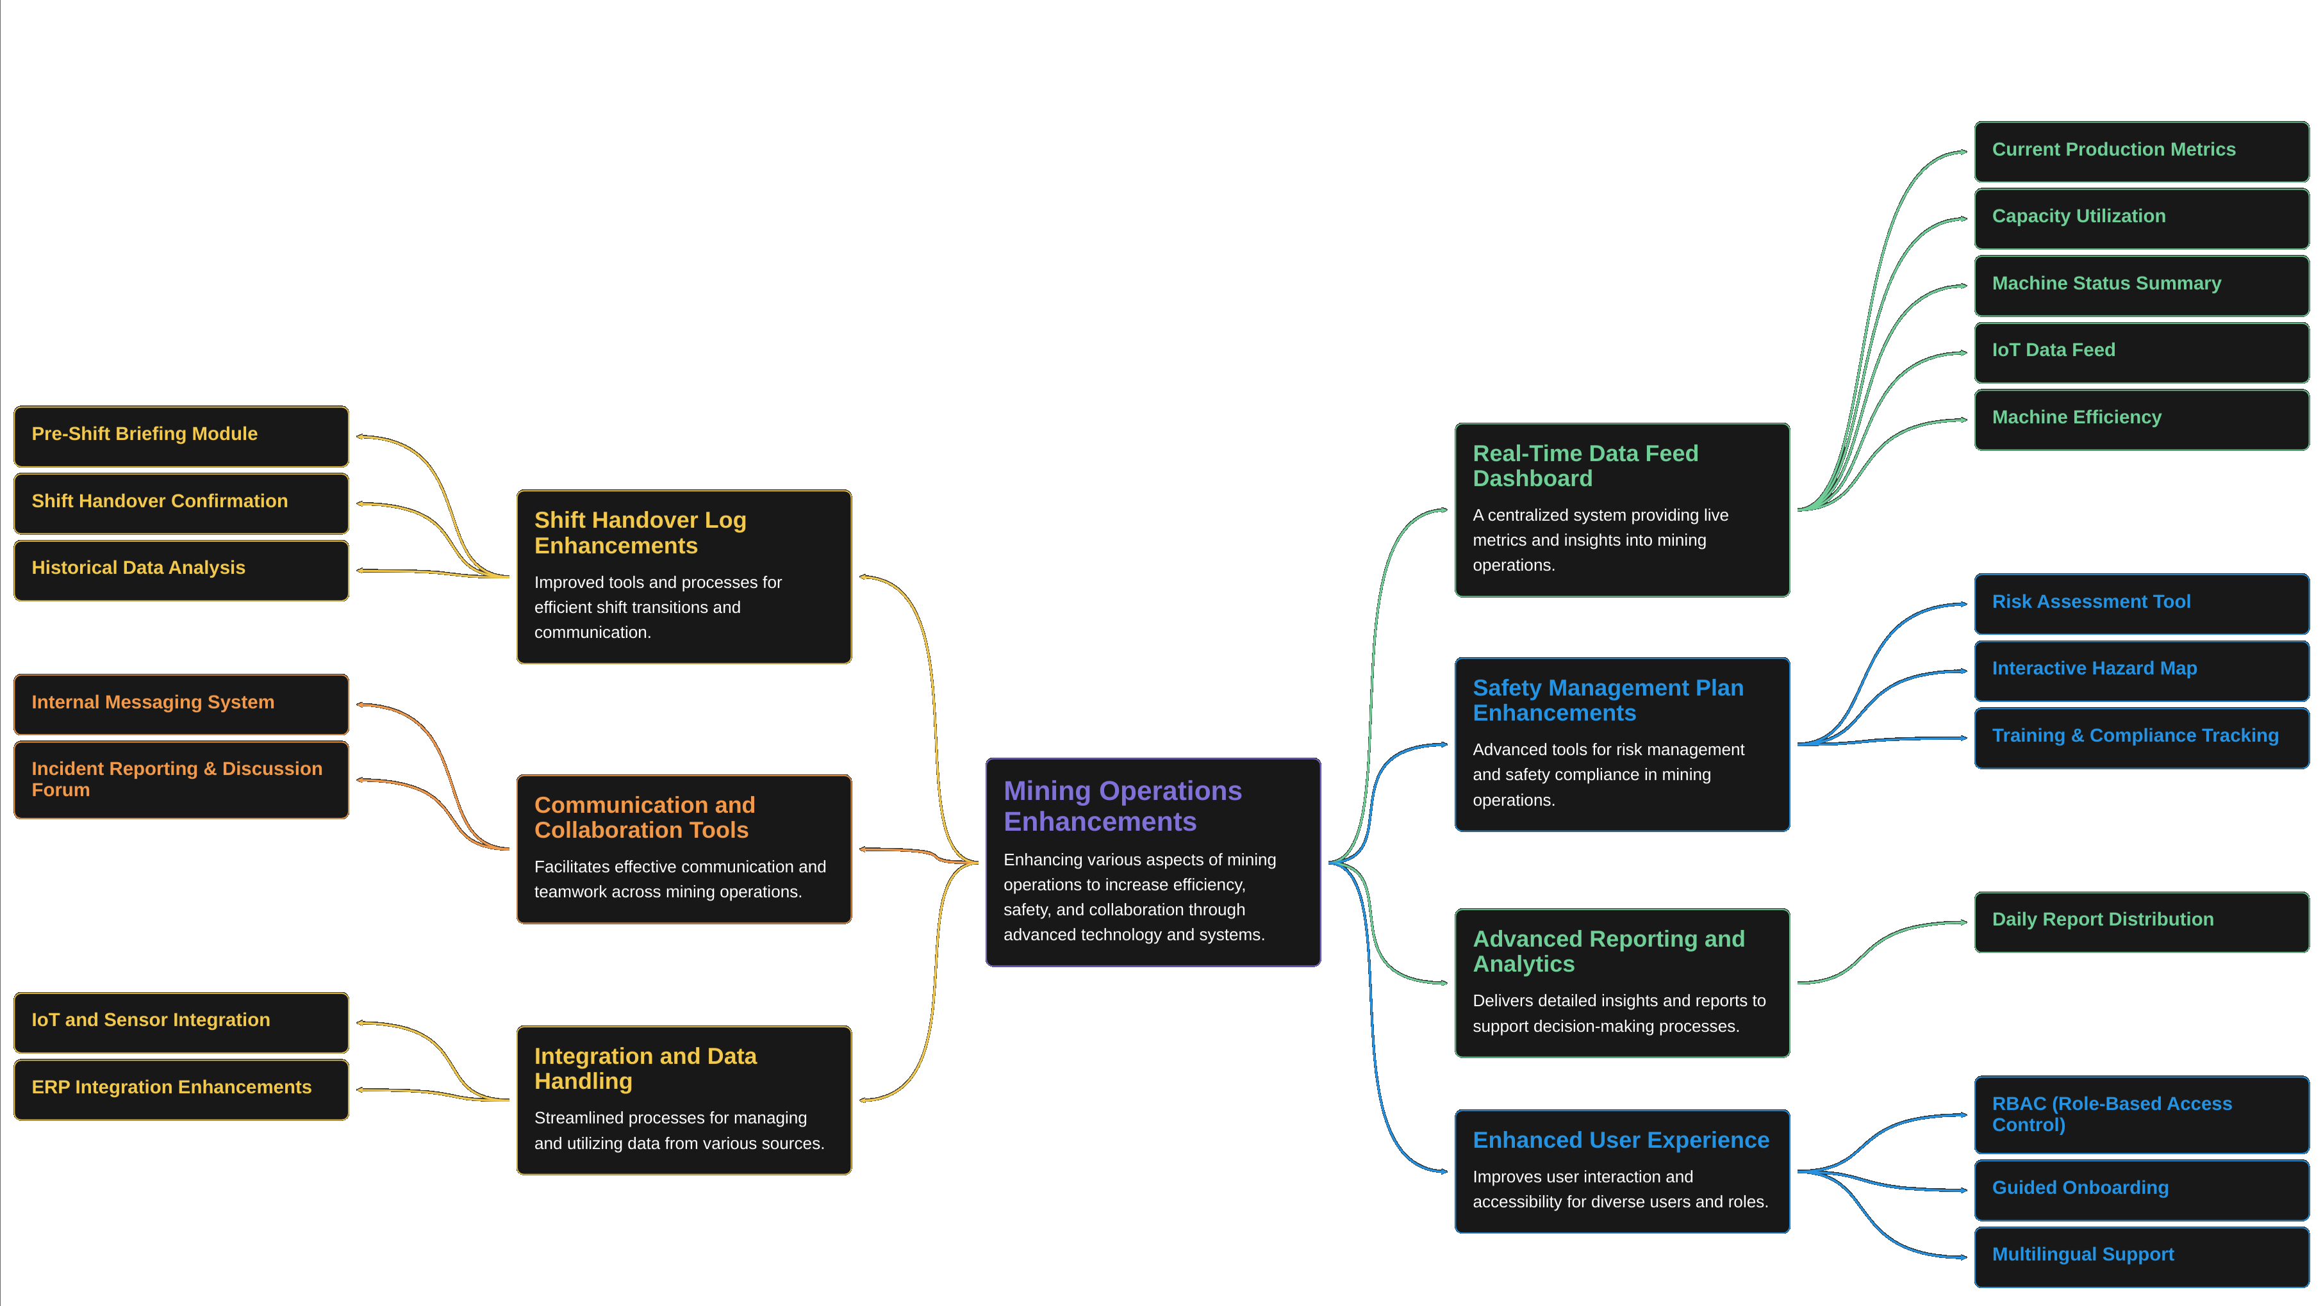
TECHNICAL APPROACH
Coal Mine Innovators

Slide 4
FEASIBILITY AND VIABILITY
Coal Mine Innovators
ANALYSIS OF FEASIBILITY:
POTENTIAL CHALLENGE AND RISK:
OPERATIONAL
BUISNESS
MARKET
CONNECTIVITY
TRANSPIRANCY
ACCOUNTIBILITY
HEALTH
OPERATIONAL
FINANCIAL
TECHNICAL
INFLAMMATION
SOLUTION TO CHALLENGES:
DIGITALIZATION
ACCESSIBILITY
CONNECTIVITY
TRANSPIRANCY
SAFETY
TECHNICAL

Slide 5
IMPACT AND BENEFITS
Coal Mine Innovators
1. ENHANCE TRANSPARENCY:
.
Improved transparency can reduce corruption and illegal financial activities, ensuring workers receive accurate salaries and funds. This, in turn, can help reduce poverty and improve their quality of life.
3. WORKERS AND ENVIRONMENT SAFETY:
.
The project will enhance workers safety and reduce environmental harm through stricter safety protocols and real time hazard monitoring.
2. REDUCTION IN CORRUPTION AND FAIR WAGES FOR LABOUR:
The project will increase transparency between the government and the coal mine industries , promoting accountability.

Slide 6
RESEARCH AND REFERENCES
Coal Mine Innovators
GITHUB LINK
https://github.com/Gaurav-K-Github/SIH_2024
FIGMA
https://www.figma.com/proto/pB3dG3H7WpPC1TgY9GPSxi/Untitled?node-id=46-19&node-type=CANVAS&t=l0Dqf9Bc4wHAGhwU-1&scaling=scale-down&content-scaling=fixed&page-id=0%3A1

